Slide 1



BIOSOC
SUMMER PROJECT
BIOBYTES
ML IN BIOLOGY
MENTORS: NISCHAY PATEL AND SIKHA VAMSI
Group 4:
Md. Waqar Moid
Sritama Sarkar
Bhavnoor Singh

Slide 2

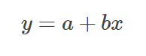
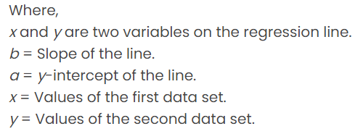
LINEAR REGRESSION
Equation of simple linear regression
Linear regression is a supervised machine-learning algorithm that learns from the labelled datasets and maps the data points to the most optimized linear functions.
When there is only one independent feature, it is known as Simple Linear Regression, and when there are more than one feature, it is known as Multiple Linear Regression.
Linear regression is classified as a regression algorithm because it is designed to predict a continuous outcome (dependent variable) based on one or more input features (independent variables).

Slide 3

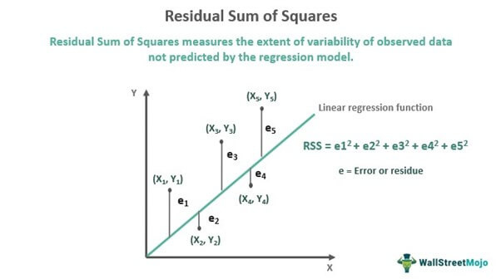

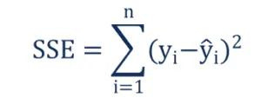
LINE OF BEST-FIT
A Line of best fit is a straight line that represents the best approximation of a scatter plot of data points. It is used to study the nature of the relationship between those points.
The sum of squares distance minimization refers to the process of finding the best-fitting line through a set of data points by minimizing the sum of the squared differences (distances) between the observed values and the values predicted by the line.

Slide 4
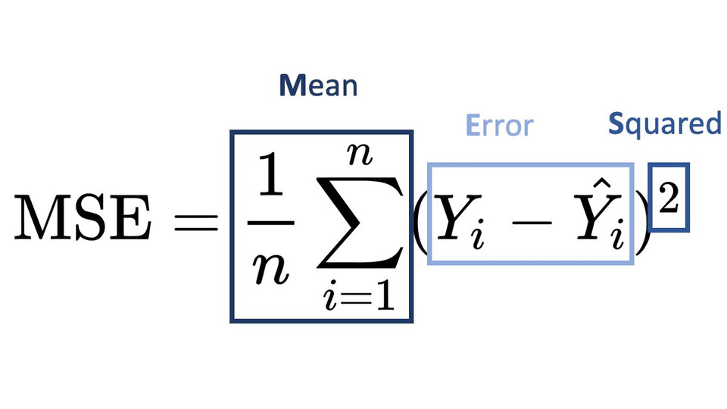
COST FUNCTION
Note that, if y = a+bx is our model’s predicted Best-Fit Line for some x, and y’ is the actual values, then it is intuitive to say that y’-y is the error in the prediction.
By observation, we can say that this error can be positive as well as negative, implying that the predicted value can be more or less than the actual value, and our goal is to minimize the gap between the predicted and actual values.
As a result, we use the squared errors as a measure to figure out the gap, rather than simply the difference between them.
Therefore, our cost function for Linear Regression (generally) is MSE or Mean Squared Error an our target is to minimize this cost function.

Slide 5

HOW TO MINIMIZE THE COST FUNCTION?

Slide 6
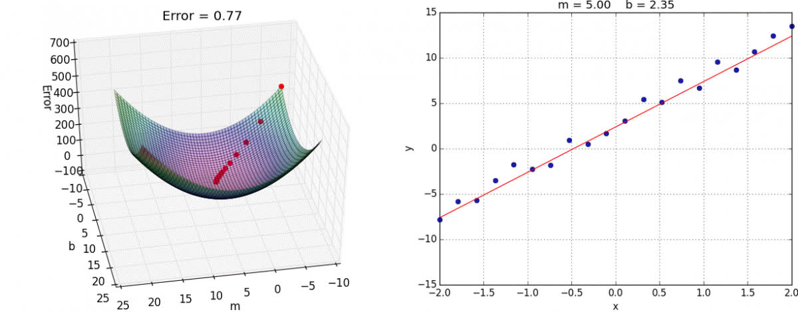
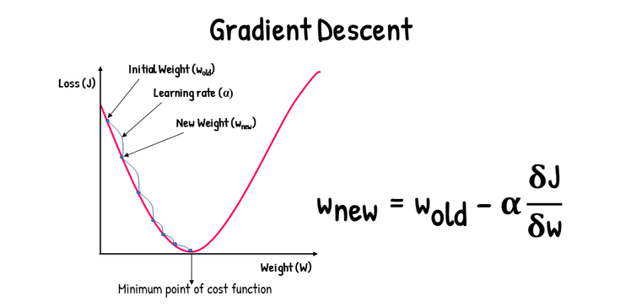
#Technique 1
GRADIENT DESCENT
Gradient Descent is one of the optimization algorithms that optimize the cost function (objective function) to reach the optimal minimal solution. To find the optimum solution, we need to reduce the cost function (MSE) for all data points.
A regression model optimizes the gradient descent algorithm to update the coefficients of the line by reducing the cost function by randomly selecting coefficient values and then iteratively updating the coefficient values to reach the minimum cost function as shown in the images.

Slide 7
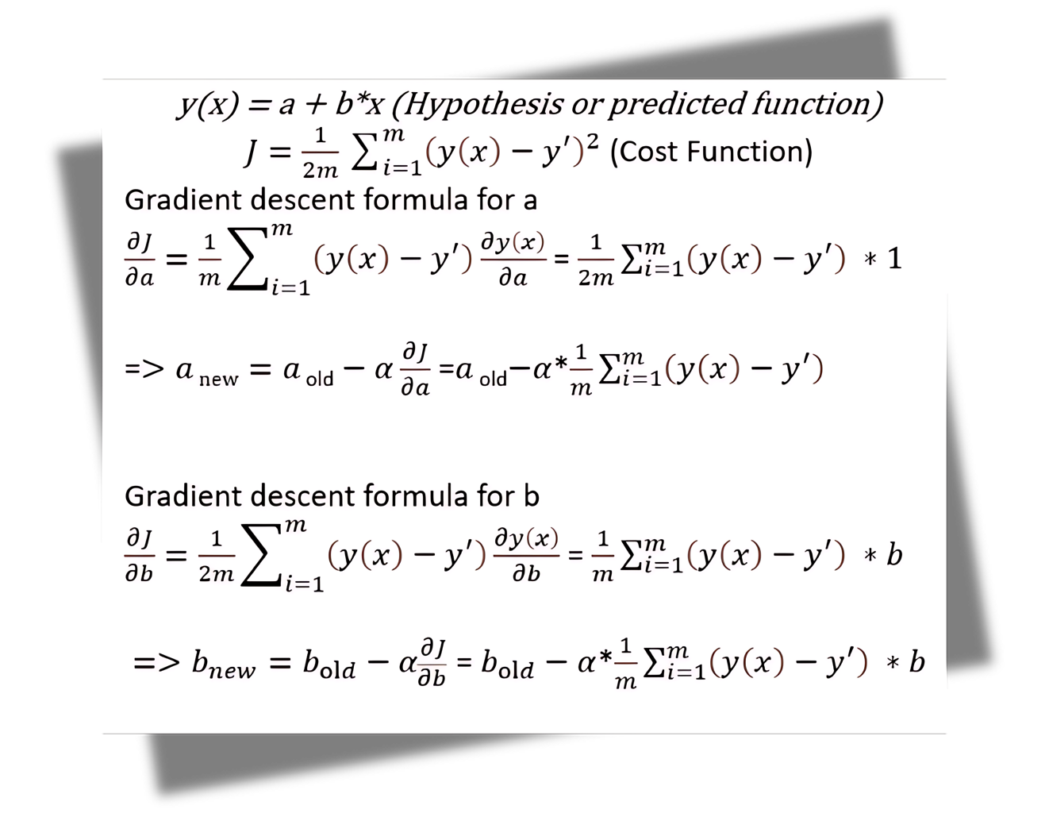
#Technique 1
GRADIENT DESCENT

Slide 8
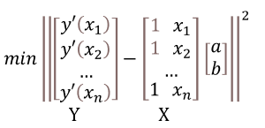
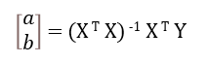
#Technique 2
LINEAR ALGEBRA (NORMAL METHOD)
The problem of minimizing the cost funciton can be alternatively written as:
We get the solution to the above Least Squares Problem via linear algebraic techniques as:

Slide 9
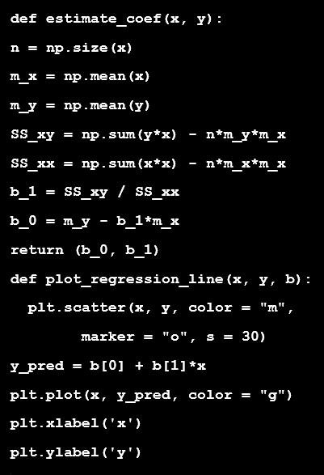
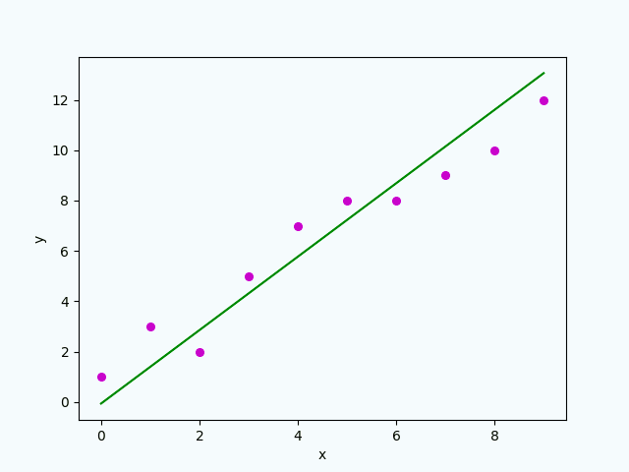
MODEL IMPLEMENTATION
BUILDING MODEL FROM SCRATCH
OUTPUT : REGRESSION LINE

Slide 10
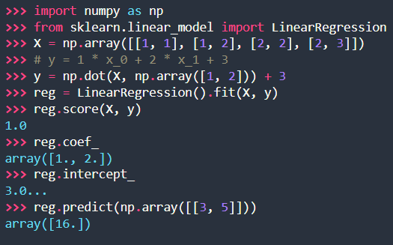
MODEL IMPLEMENTATION
USING SCIKIT LEARN LIBRARY

Slide 11
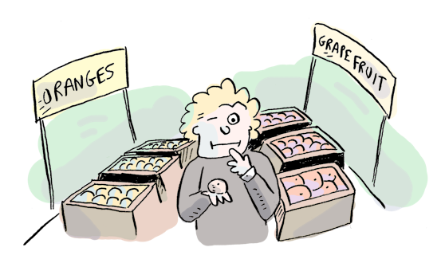

UNDERSTANDING
LOGISTIC
REGRESSION

Slide 12
WHAT IS LOGISTIC REGRESSION ?
A foundational technique in predictive modelling that bridges the gap between simple linear models and complex neural networks in deep learning. It is used to describe data and to explain the relationship between dependent binary variables and one or more nominal, ordinal, interval or ratio-level independent variables.

Slide 13
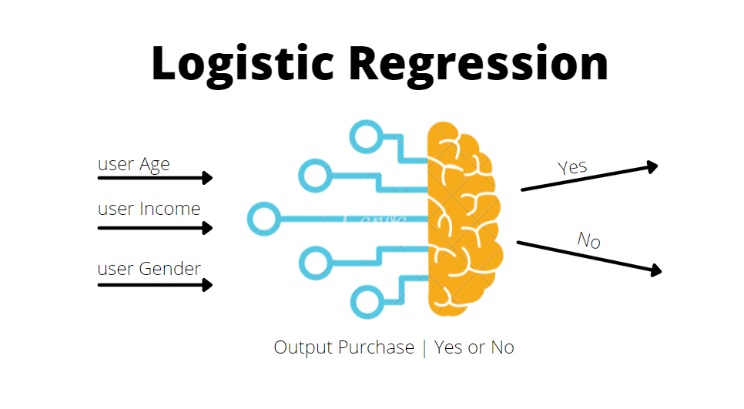
WHEN TO USE?
Appropriate for conducting when the dependent variable is dichotomous (binary). It just means that a variable that has only two outputs can either be yes or no.

Slide 14
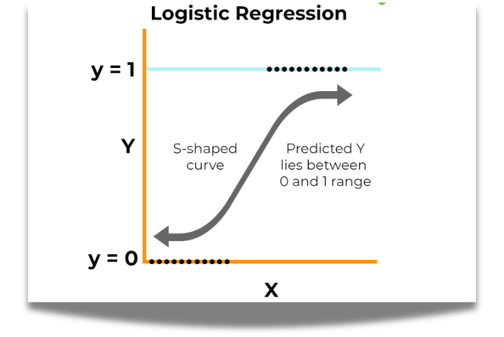
TYPES:
Binary Logistic Regression
Ordinal Logistic Regression
Multinomial Logistic Regression

Slide 15
WHY USE LOGISTIC REGRESSION?
Versatility: Can handle binary, ordinal, and multinomial outcomes
Interpretability: Provides probabilities for outcomes, making it intuitive.
Applications: Widely used in fields such as medical research, finance, and marketing

Slide 16
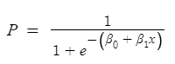
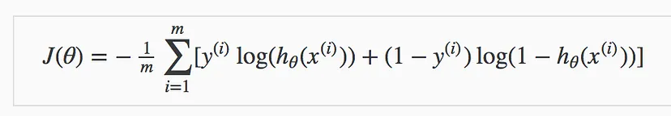
THE LOGISTIC FUNCTION
Formula:
Cost Function:
The logistic function (also called the sigmoid function) maps any real-valued number into a value between 0 and 1.

Slide 17
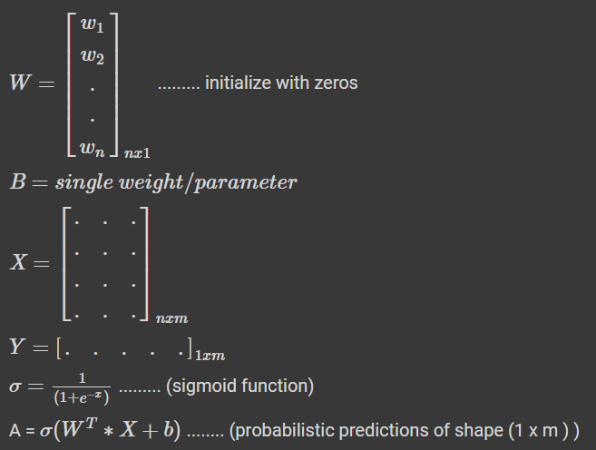
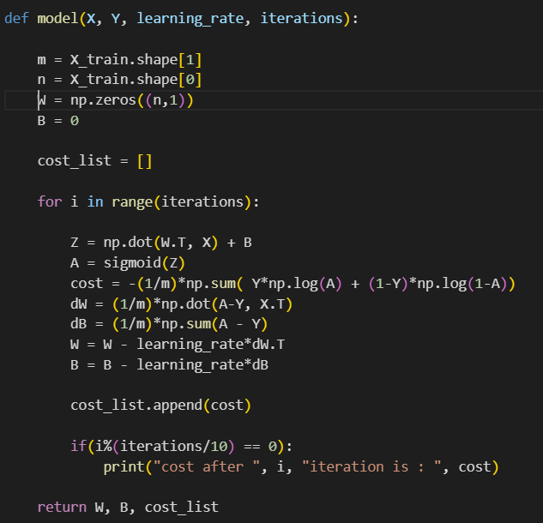
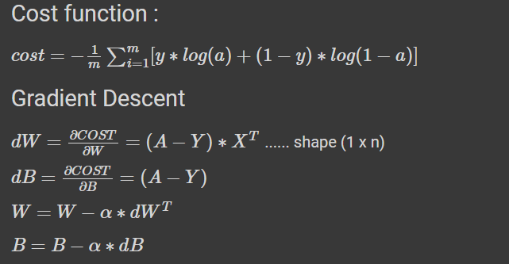
MODEL IMPLEMENTATION

Slide 18
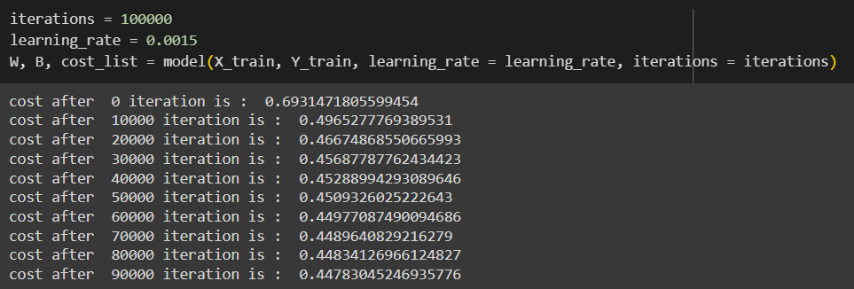
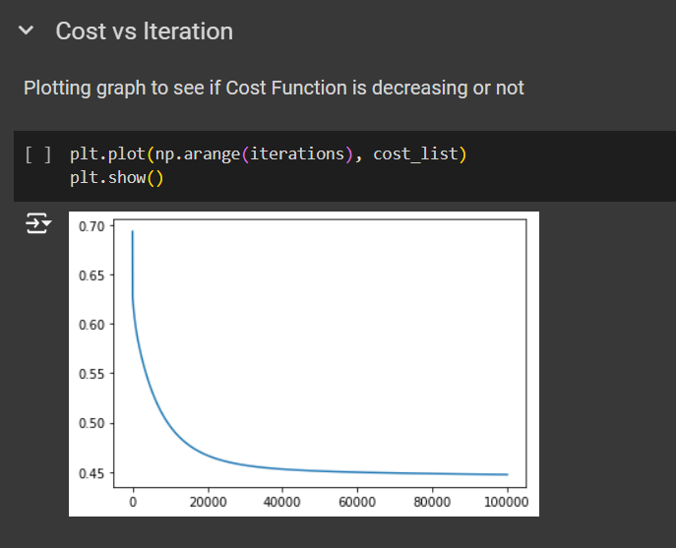
MODEL IMPLEMENTATION
(Using Titanic Dataset)

Slide 19
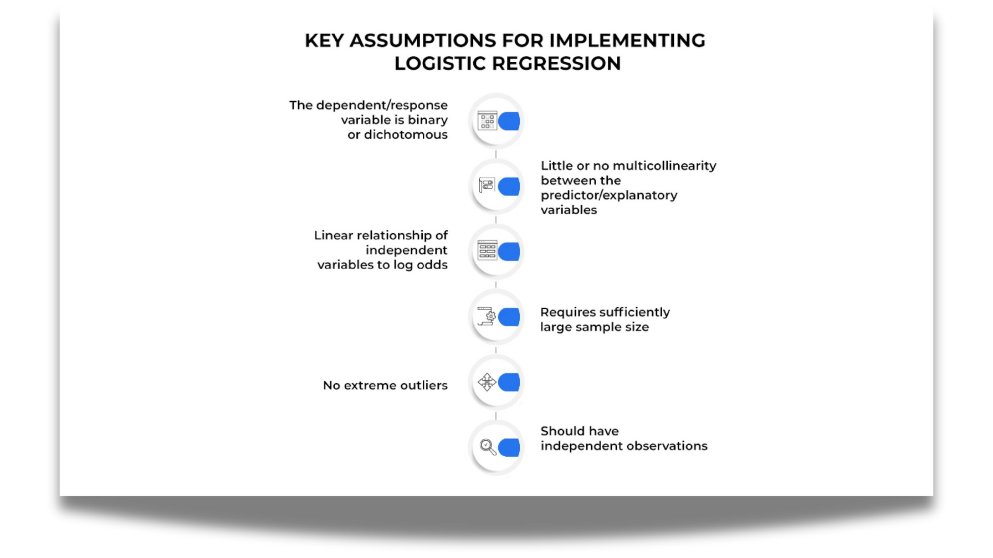
ASSUMPTIONS:
Data Specific: Binary dependent variable, independent observations
Relationship Between Variables: Linearity in the logit, no multicollinearity
Others: Absence of outliers, adequate sample size

Slide 20
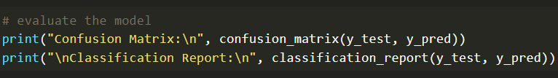
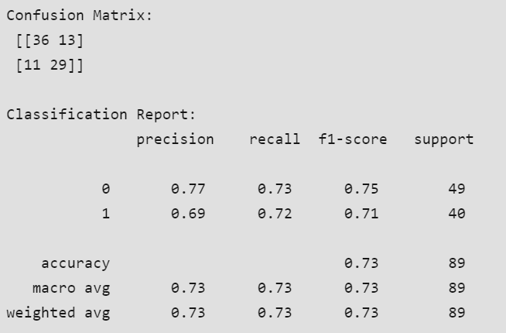
MODEL EVALUATION:
(Using Diabetes Dataset)
Confusion Matrix Method:
Output:

Slide 21
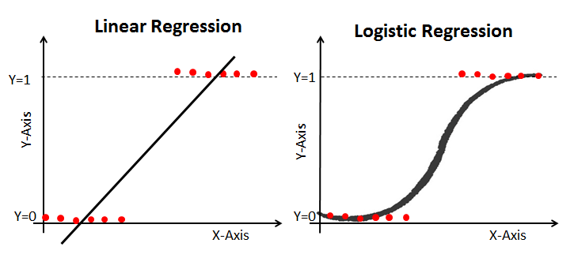

ADVANTAGES AND LIMITATIONS:
Advantages
(Logistic Regression vs. Linear Regression): Linear Regression excels at predicting continuous values along a spectrum. Logistic Regression, on the other hand, deals with categories. It doesn’t predict a specific value but rather the likelihood of something belonging to a particular class.
Limitations:
Assumes linear relationship between logit and predictors.
Sensitive to outliers and multicollinearity.
It is tough to obtain complex relationships using logistic regression. More powerful and compact algorithms such as Neural Networks can easily outperform this algorithm

Slide 22

CONCLUSION:
Logistic regression is a powerful tool for handling categorical variables and predicting binary outcomes. Unlike decision trees, which create non-linear decision boundaries, logistic regression uses a linear relationship transformed by the exponential function through an activation function.
Validation is a key step to ensure the model’s performance on unseen data, by splitting data
The decision boundary in logistic regression is a linear separator, unlike decision trees, which create non-linear boundaries.
The sklearn library in Python provides robust tools for implementing logistic regression models.
Overfitting can occur in logistic regression, it’s crucial to employ techniques such as regularization to mitigate this issue.
Logistic regression can be viewed as a linear model where the output is passed through an activation function, specifically the sigmoid function.
KEY TAKEAWAYS:

Slide 23

Thank You!!

